Slide 1
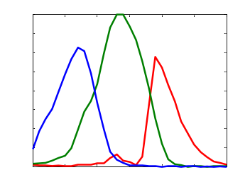
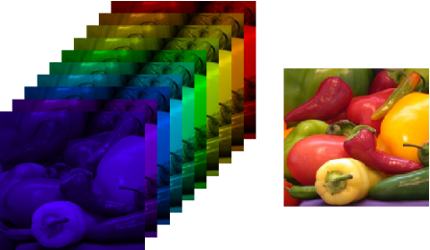
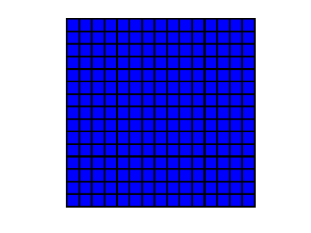
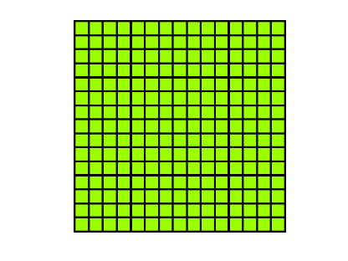
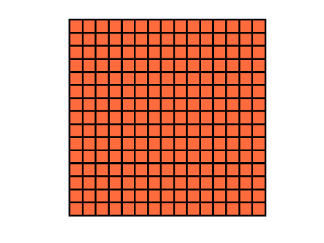




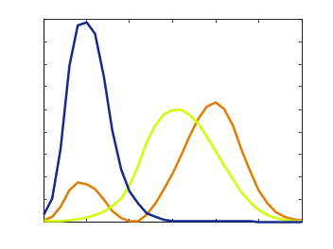
Camera
Sensor
Noise descriptors
Resolution
Sensitivities
Lens
Lens description (f#)
Field of view
Scene
Reflectance
Reflectance measured at each pixel
Distance from camera
Noise Free Image
Bands are from both the camera and the desired output
Sensor parameters are included
L3scenes2sensordata.m
Illuminant
Shape
(Intensity)
Desired Bands
Notes:
The output from this code is a noise free image that contains all of the information required from the scene for our calculations. The image contains all of the bands that the camera can observe and the desired output bands. Each band is the output from an ideal sensor that measures with the desired sensitivity at each pixel. The image can be subsampled and corrupted with noise to simulate capture with any CFA. The desired bands give the ideal image that we wish to estimate.
This code save computation and memory later by completing all tasks associated with the scene and optics. This is because the reflectance image tends to be very large in relation to the noise free images, and the optics calculation is relatively slow.
The scene currently is modeled as a flat surface at a distance from the camera that has the desired reflectance and is illuminated evenly with the desired illuminant. If desired, the intensity of the illuminant can be specified later. This is advantageous if the simulation will run over many different light levels.
The desired bands for the final estimated image must be specified. There can be any number or shape for these bands. For example, they could be the XYZ functions if our image is to be perceived by humans. Or they could be specifically tuned for specific medical diagnosis. They could also be a large number of narrow wavelengths if a multispectral output is desired.

Slide 2
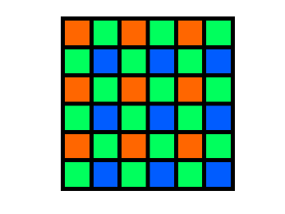
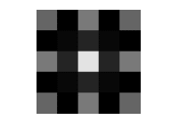
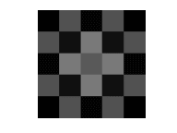
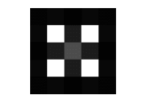
Illuminant
Intensity (mean luminance)
CFA Layout
Noise Free Image
(Training Data)
Bands are from both the camera and the desired output
Sensor parameters are included
L³ Tables
All filters and clustering descriptors for L³ algorithm
L3trainpipeline.m
L³ Parameters
Size of patches (9x9 pixels?)
Percent of flat patches
Tree depth (for clustering of texture patches)
Number of training patches to use
Notes:
All of the training for the L³ algorithm occurs here. The training takes much longer than it does to actually process an image. The larger the training set that is used, the longer the calculation takes but may result in better performance.
Ideally the training data would well represent scenes from the typical use of the camera in practice. The training data should ideally contain a number of images from different scenes but I think a huge number (hundreds) of images should not be needed or very beneficial.
The intensity of the illuminant can be altered at this stage if desired.
The CFA layout, L³ parameters, and illuminant intensity are included here so that the previous code does not need to be rerun for any changes in these variables.

Slide 3
L³ Tables
All filters and clustering descriptors for L³ algorithm
Noise Free Image
(Testing Data)
Bands are from both the camera and the desired output
Sensor parameters are included
Reconstructed Image
Estimated Image in desired bands after
Can compare to ideal images obtained using particular error metric
L3wrapperimage.m
Error Metric(s)?
Notes:
This code takes images from the test data, simulates the RAW sensor output, and uses the L³ algorithm to estimate the image in the desired bands. The code runs quickly and the L³ estimation step would be the only one done in practice.
An error metric that measures the quality of the reconstructed image can be included. The error metric compares the estimated image with the ideal image taken by using the output bands from the noise free images. The error metric is not required but helps in system evaluation and design.
Some additional images can be generated to assist with understanding how the L³ algorithm is performing.

Slide 4
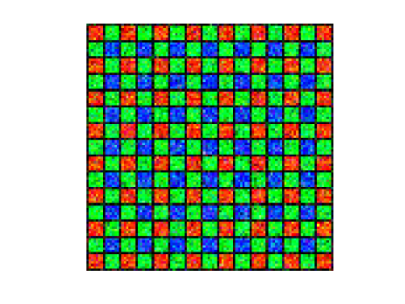
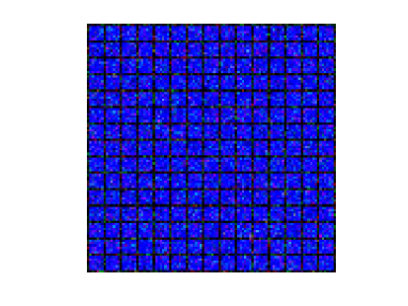
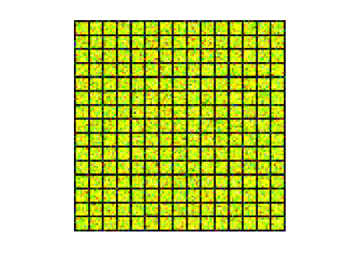
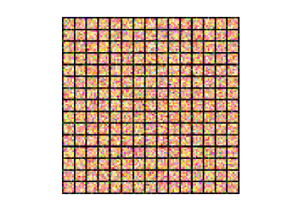
Work flow inside L3wrapperimage.m
Noise Free Image (Testing Data)
Desired Bands
Error Metric(s)?
Measured Bands
Simulated RAW Image
Image Estimate
L³
Notes:
For clarity, This is an illustration of the calculations that occur inside wrapperimage.m.
The noise free image from the testing data is split into the measured bands and the bands in our final desired image.
The measured bands are subsampled according to the CFA and corrupted by simulated noise.
The L³ algorithm is run on the simulated RAW image to generate the output image estimate in the desired bands.
The desired bands from the noise free image represents the ideal output and can be compared to our estimate using an error metric.

